Slide 1
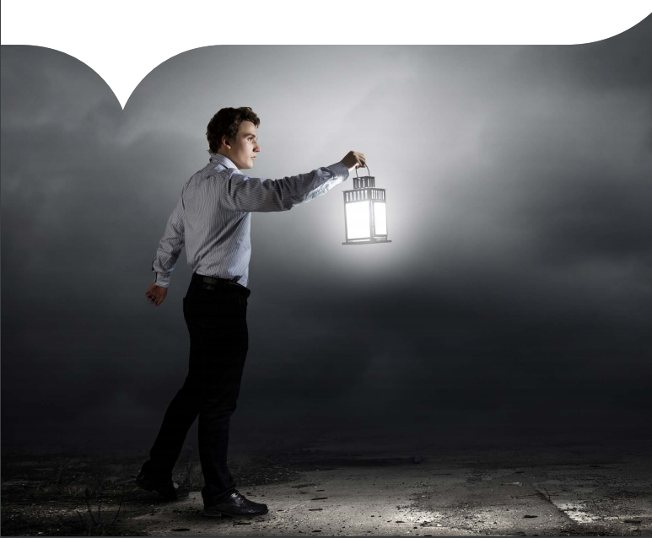
Boston City UTILITY Consumption
Group 4
Ananya Chakravarty
Rohit Nigam
Rohit Nikam

Slide 2
Introduction
Boston Government has many departments which are placed at different geographical locations in the Greater Boston Area.
The people belonging to these departments work in buildings constructed as per their needs.
Every building needs utilities such as Water, Gas, Steam, Fuel, Electricity, Oil etc.
The costs incurred on these utilities is massive and is taken into consideration during the planning phase of one such infrastructure construction.

Slide 3
Dataset
Dataset1 - This dataset gave us the Total Cost incurred and the Total Usage of different utilities such as Gas, Water, Electricity, Steam and Fuel from multiple vendors (such as VEOLIA, HESS and EVERSOURCE for electricity). The data was collected on the basis of billing month which had Day, Month, Year of Utilization and also the Zip, Area of the infrastructure.
Dataset2 - We found another dataset which gave us the weather normalized data for different utilities on each day for various locations in and around Boston.
Dataset3 - The third dataset contained data about CO2 Emissions in all the departments in Boston based on the utility consumption.

Slide 4
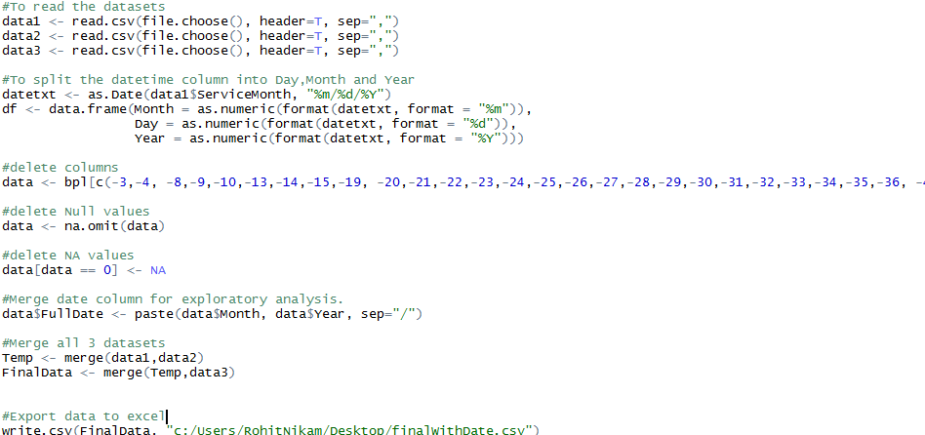
Preprocessing USING R
Step1 – Remove nulls and NA
Step2 – Remove unnecessary attributes
Step3 – Merge datasets
Step4 – Split date column into day, month and year.
Step5 – Align location and address of the infrastructure as per ZIP
Step6 – Split location to get latitude and longitude for exploratory analysis
Step7 – Remove Outliers
Step8 – Sort as per the month of usage and group by department

Slide 5
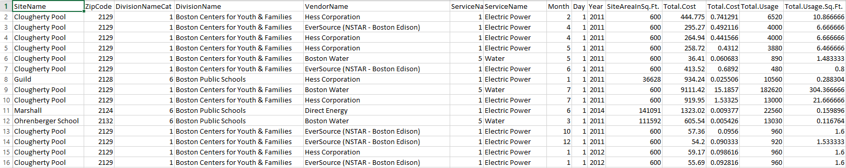
Final Dataset
SiteName
Department
SiteZip
Month
Year
TotalArea
UtilityType
UtilityVendor
TotalCost
TotalUsage
WeatherNormalization
CO2Emissions

Slide 6
Web-app Idea and features
IDEA
Our approach towards analysis of Boston Utility Consumption is to categorize the data depending on various departments like Boston Police Department, Boston Fire Department, Boston Public Library, etc. and publish a website to predict the Total Cost of each utility based on different departments located in different locations.
FEATURES:
Dashboard for easy online access and visualization of utility consumption cost for different departments in Boston
Enabling user to predict utility consumption value and cost by selecting the Month, Year, Zip, Area, Department and Type of Utility
Enabling user to choose between multiple departments, timeframe and unit to visualize the prediction data

Slide 7





technologies
Data Preprocessing – R
Prediction – Azure Machine Learning Studio
Visualization – Tableau
Front-End – HTML, CSS, Bootstrap, JavaScript

Slide 8
Prediction model
For predicting the utility consumption cost, we used Boosted Decision Tree Regression model in azure machine learning studio. It is a supervised learning method to create ensemble of regression trees.
Properties:
Used Projected Column to filter out the columns, which did not contribute to our prediction.
Used Metadata editor to send the department and utility as categorical values.
Split the data as Train and Score (70% traning)
Used Boosted Decision Tree Regression to predict total cost values
Consider utility prediction as our output/predicted value

Slide 9
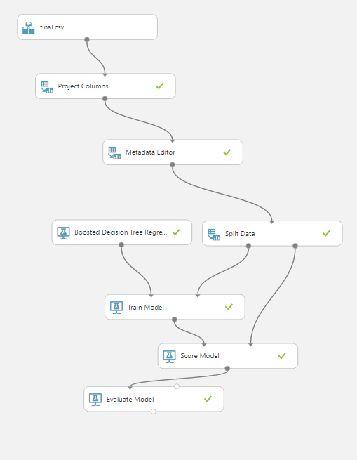
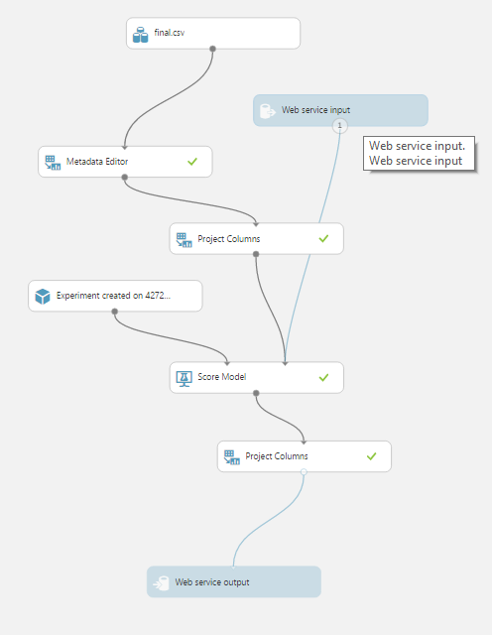
MODELS
TRAINING MODEL
PREDICTIVE MODEL

Slide 10
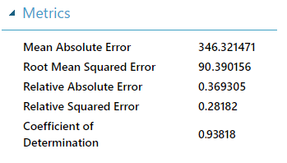
Accuracy
The coefficient of Determination for the model is evaluated as 0.93, which shows that the dependent variable can be predicted from the independent variable with less error.

Slide 11
Why boosted decision tree regression?
The explanatory attributes in our dataset are mostly numeric and if they’re not numeric they’re categorical. We have converted all categorical data into numbers and decided to use a regression algorithm.
Boosting is one of several classic methods for creating ensemble models, along with bagging, random forests, and so forth.
We compared 4 different regression algorithms Linear Regression, Neural Network Regression, Bayesian Linear Regression and Boosted Decision Tree Regression algorithms to figure out which one to use for our model and which one accurately predicts the Total Utility cost for each department. Below is the model that we created to compare the accuracy of the algorithm.

Slide 12
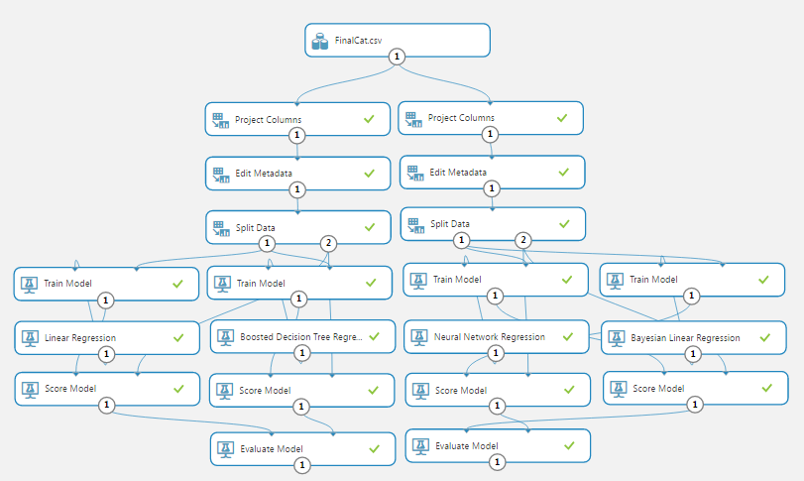
Why boosted decision tree regression?

Slide 13
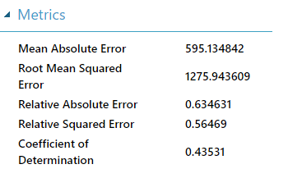

comparison
Linear Regression Boosted Decision Tree Regression
Neural Network Regression
Bayesian Linear Regression

Slide 14
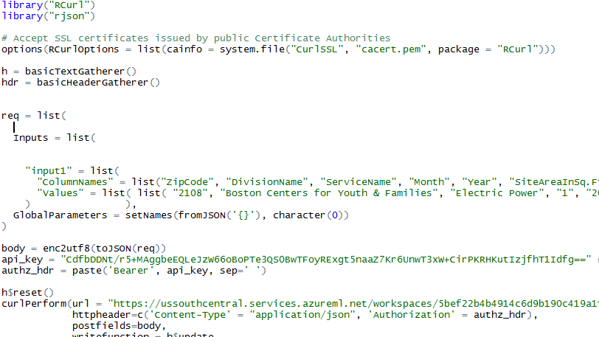
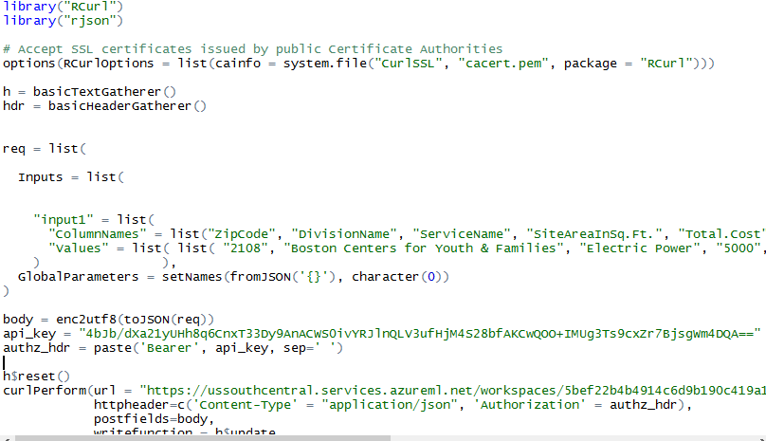
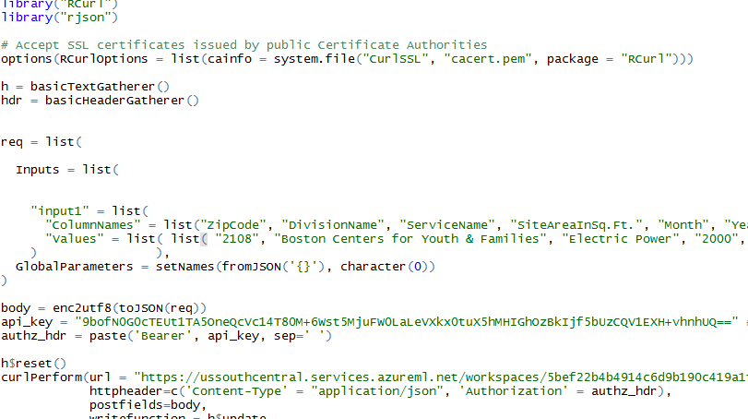



Prediction using r
Predict Cost Weather Normalization CO2 Emissions

Slide 15
DEMO

